Slide 1
Developing State Alliances
to Speak as One Voice
Presentation by
Susanna Miller-Raines

Slide 2
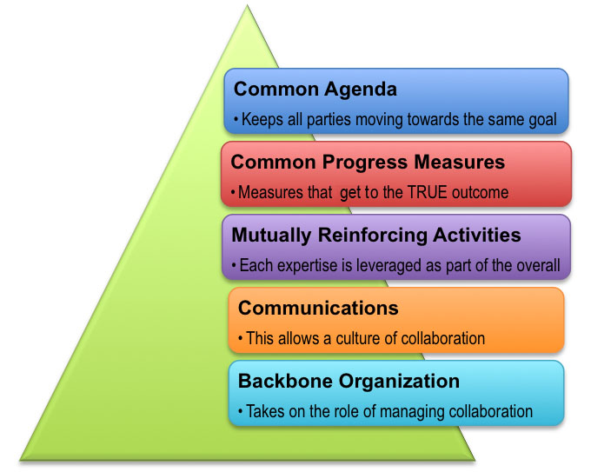
Collective Impact

Slide 3

Common Agenda
Policymakers
Providers
K-12 System
Institutions of Higher Education
Parents
Bring people together for a Common Agenda, inclusive postsecondary education.
State agencies
DD Network

Slide 4
Create a Leadership Team
University Center for Excellence in Developmental Disabilities (UCEDD)
Developmental Disability Council (DD Council)
Protection and Advocacy Organization (P&A)
Department of Education
Vocational Rehabilitation Agency
Developmental Disabilities Agency
AT Act Program
Center for Independent Living)
IPSE program representatives
Parent groups
Any other stakeholders

Slide 5
Common Progress Measures
Alignment & accountability
Inclusion
Academics
Employment
Self efficacy
Self determination

Slide 6

Strategic Planning
Vision
Mission
Role Clarification
1 year planning
5 year planning

Slide 7
Mutually Reinforcing Activities
Having an action plan
Legislative Advocacy
Technical Assistance
Employment preparation
Assistive Technology
Transition Planning
Funding

Slide 8
Communications
Building trust, assuring mutual objectives, & common motivation
Quarterly Face to Face Meetings
Emails as needed
Phone conversations

Slide 9

Backbone Organization
Coordination of participating organizations and agencies

Slide 10
Suggested Steps to Creating an Alliance
Choose a coordinator/backbone organization
Come up with a common vision for your state
Host quarterly or semi annual meetings of Leadership Team
Host a statewide meeting with all stakeholders
Provide technical assistance to interested colleges and universities
Create a social media presence
  Facebook Group
  Facebook Page
  Twitter profile
Build Capacity Across Your State

Slide 11
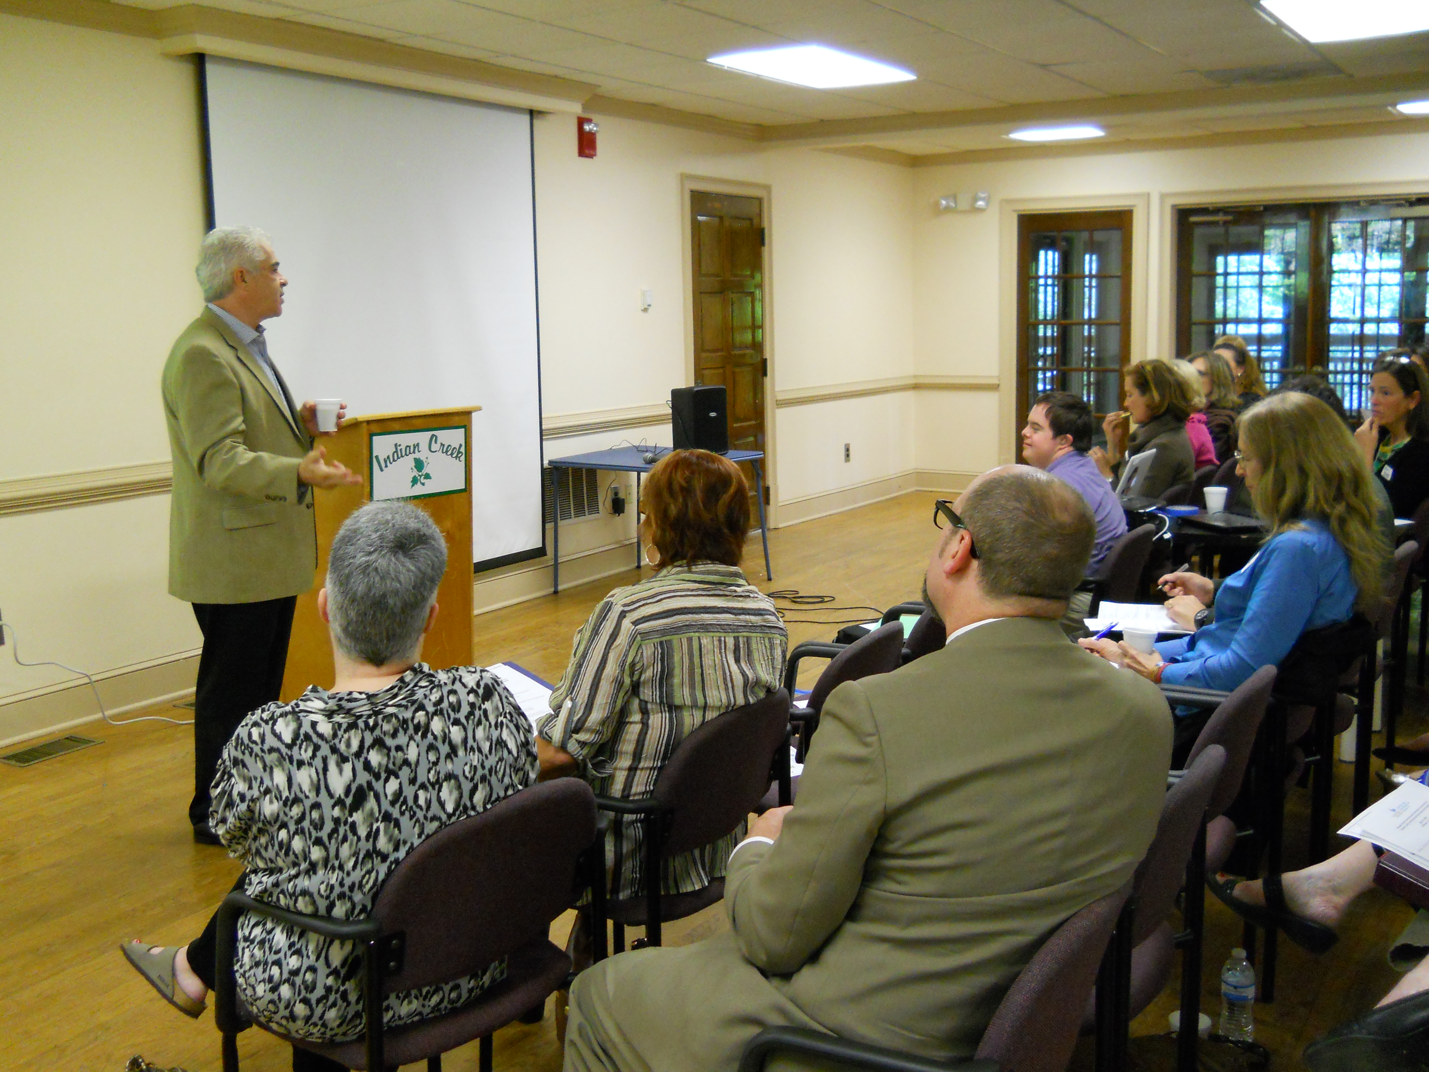
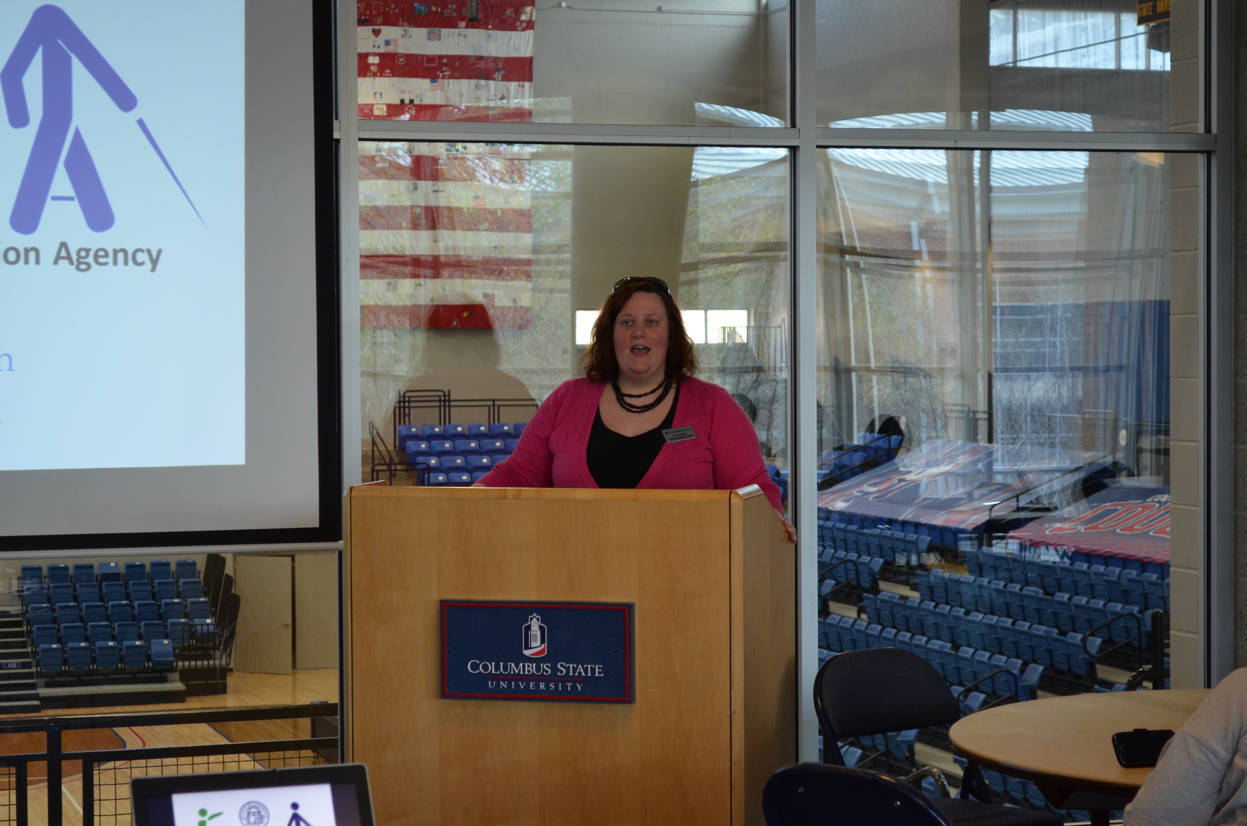
Building Capacity Across Your State
Statewide Consortium Meetings
Educator Seminars
Webinars
Presentations at Transition Fairs
Presentations at state conference
  VR conference
  DOE conferences
  Other conferences
Presentations to parent groups
Legislative Advocacy

Slide 12
Contact Information
Susanna Miller-Raines
smiller65@gsu.edu

